Slide 1

Just Monkeying Around
February 12, 2020
Notes:
Ahnaf

Slide 2
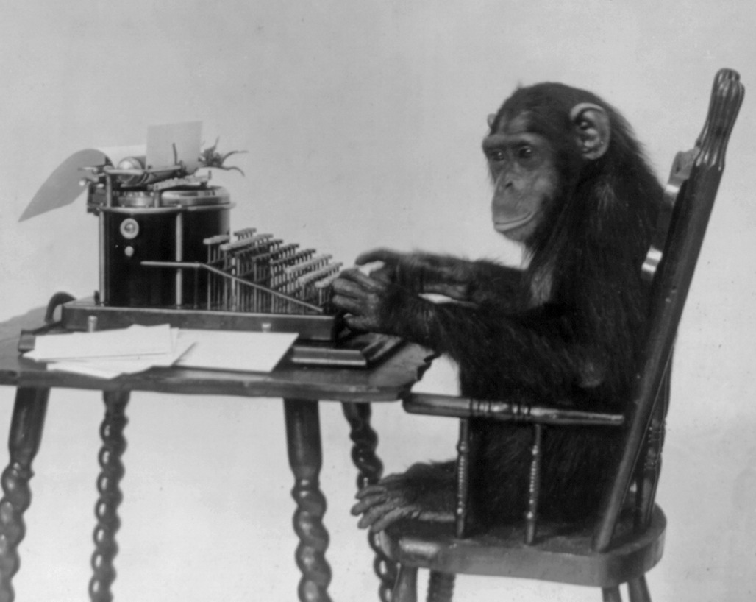
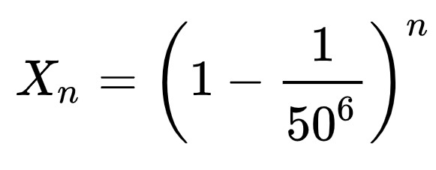
Inspiration
The infinite monkey theorem states that a monkey hitting keys at random on a typewriter keyboard for an infinite amount of time will almost surely type any given text, such as the complete works of William Shakespeare.
Probability of NOT typing “Banana”
Notes:
Ahnaf

Slide 3
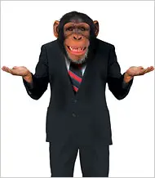
In Practice
In 2003, researchers at the University of Plymouth used a £2000 grant to give 6 crested macaques a keyboard with a radio link to broadcast the results for a month.
Not only did the monkeys produce nothing but five total pages largely consisting of the letter S, the lead male began bashing the keyboard with a stone, and the monkeys followed by soiling it.
Notes:
Andy

Slide 4
Overview
Using the Infinite Monkey Theorem as our inspiration, we decided to use machine learning to create new text based on existing text. But we didn’t want to just use the works of Shakespeare; we wanted to branch out and use other famous works. In the end, our code used 6 sources, primarily from the public domain:
The Complete Works of Shakespeare
The Adventures of Sherlock Holmes
The King James Bible
The Odyssey and The Iliad
Dante’s Divine Comedy
All of Yoda’s lines from the first 6 Star Wars films
Notes:
Andy

Slide 5



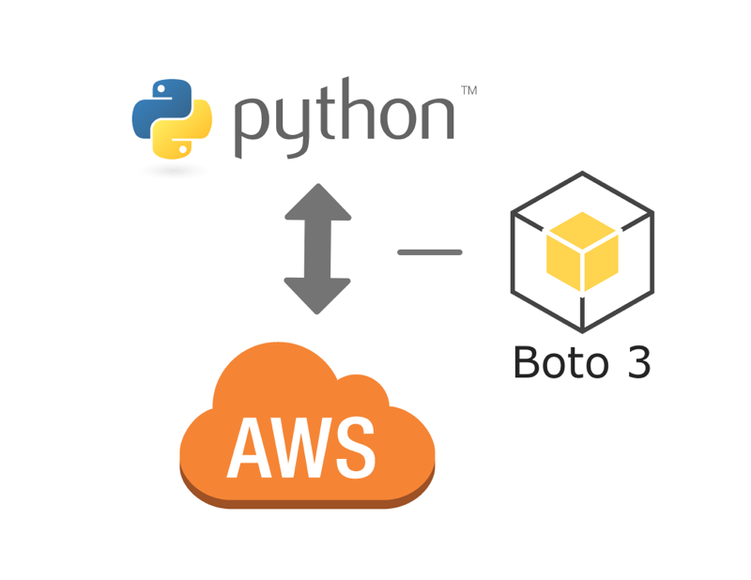


Tools Utilized
Project Gutenberg
AWS
Keras & TensorFlow
Google Colab
Python Pandas
Google Slides #HellYea
Notes:
Matt

Slide 6
Project Overview
Given a character, or a sequence of characters, what is the most probable next character? This is essentially the task we trained our model to perform. The input to the model is a sequence of characters, and we train the model to predict the output.
For example, given the sequence of characters "Shakespear", we train the model to predict the next character in the sequence "e".
To do so we used a Recurrent Neural Network (“RNN”). RNNs are unique because they allow previous outputs to be used as inputs. This difference makes it an ideal neural network for language and speech processing and, in our case, text generation.
Notes:
Matt

Slide 7

Sherlock’s Anaconda
My anaconda in this who lives upon the palm of
her engagement of our new account of the dock alluments. A drab drive, so that he could upon the side of my room and
between your bedroom this morning, there I could find
them to you upon allow in the bureau for a dirty of his assured.
Notes:
Andy

Slide 8
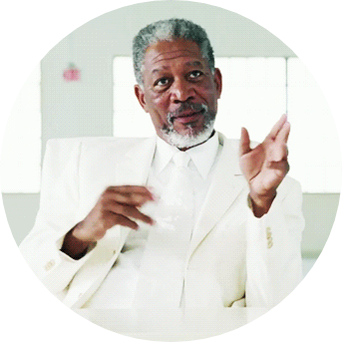
Bible with the prompt “My Anaconda”
My Anaconda faulty,
5:10 And the fools of the ning of his masters, I shall
pass over, from faces, and despirted not;
neither shall we be able to be for ever.
12:49 T as in all this, and lo, all Gemariah
the priests the throne, saying, If the spirit of Carable life
and twenty famine.
3:9 Then they answered and said unto me, Surely as then afering someth our drowness.
Notes:
Nishi

Slide 9

Yoda with the prompt “The force”
The forced side. Death is a natural part of life. Rejoice for those around you who transform into the Force. a Jedis strength flows from the Force. But beware. Anger. Luke...Luke...Do not...Do not underestight our way. If a special session of Congress there is, easier for us to enter the Jedi Temple.
An old friend has learned the path to immortality. One who has returned forever sleep. Earned it, I have. Strong am I with the Force... but not that strong!
(continuing) Careful you must be when sensing the future, Anakin. The fear of loss is a path to the dark side... fear leads to anger... anger leads to hate.. hate leads to hat ou be with toremmm... rest.
Notes:
John

Slide 10

Dante Pining for Kanye
Kanye West thus was dark
Perus'd into a fourth, wherein for any stretch'd his head.
Ahoushes, in my head
From voice spon no plumen that hath man'd or what sea,
For virtue valley. Here to meets preder violent dew.
Notes:
Zahra

Slide 11
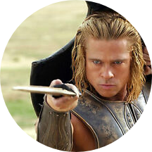
Homer’s views on Zach Durham (first of his name)
Zach is my woes
Zach is a god; thou bears thy fortune
Zach is he could give satisfaction
Zach is yonder champ!
Zach is no more than if utter sea-will vessel to come afflict, and his blind back
Zach is devote!
Zach is the bread in the pride of men
Notes:
John

Slide 12
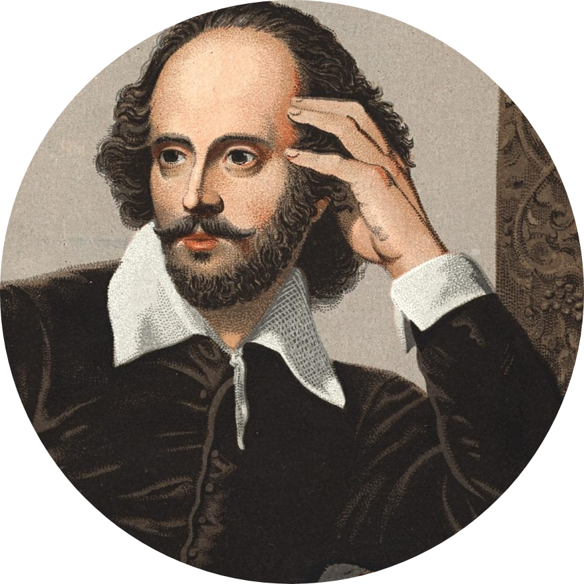
What do you think of Zach?
Zach is the bread in the pride of men
Zach is gentle looks
Zach is an English burning paper from her at the door
Zach is none."—O light I speak of truth;
Key Error - say Z, I do not
Zach is better unto him, and bleweeth unto him, and did and chased them as a fetsters, they are to be full be caused themselves to him.
Zach is Lover beams of the worst. But it cannot come.
Notes:
Ahnaf introduce and then each person plays their part

Slide 13
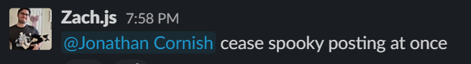

Slide 14
Test Run Time
We need a Phrase
Notes:
Ahnaf

Slide 15
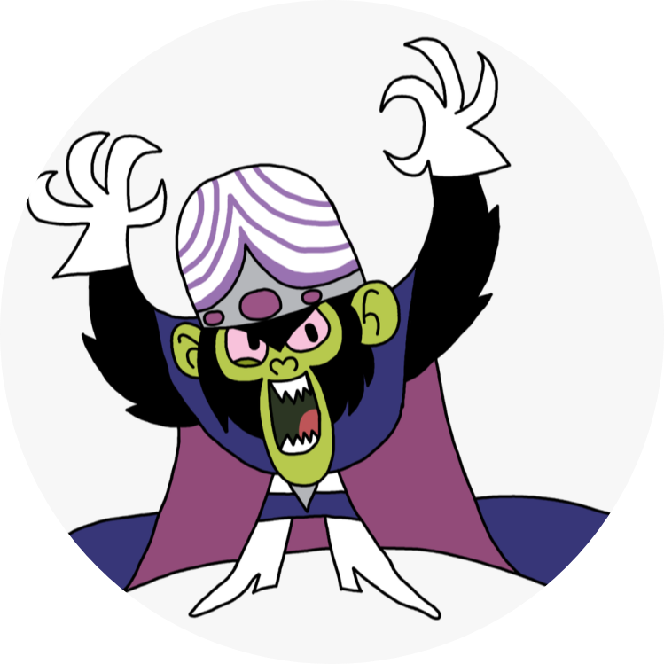
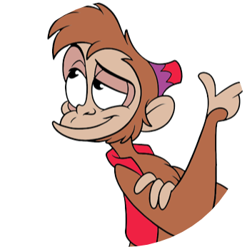
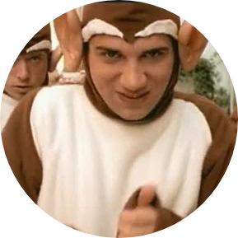
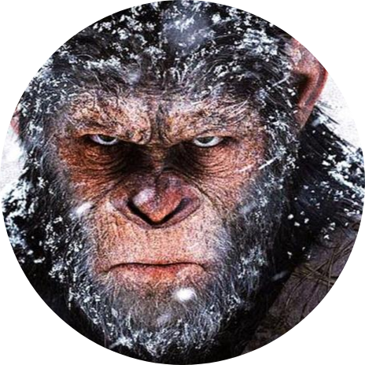
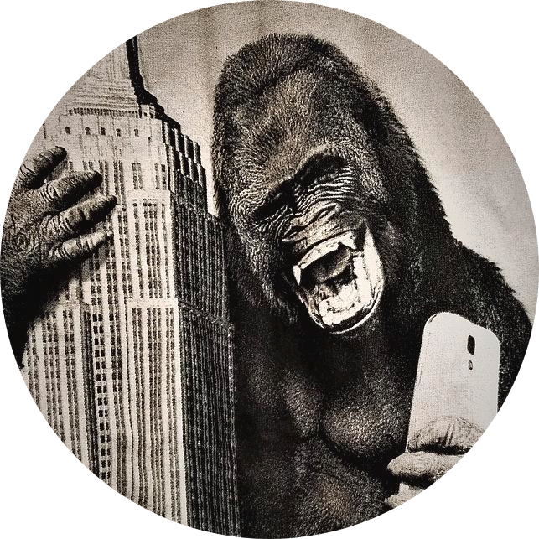
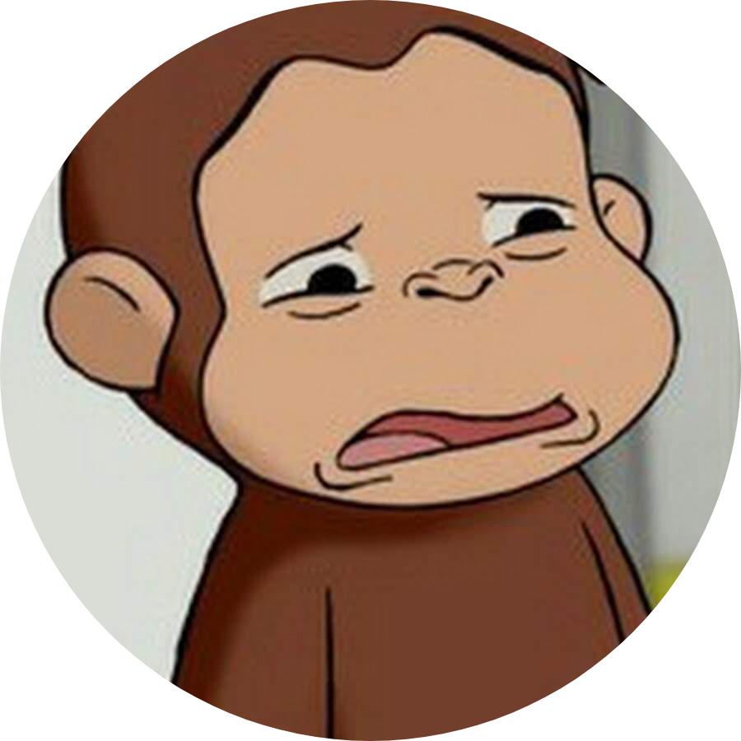
The Team
Ahnaf
Zahra
Andy
Matt
Jonathan
Nishi

Slide 16
Appendix

Slide 17
General Observations
There were a lot of interesting things that we encountered in this project. For example:
The model appeared to work best for text when the style of the text is unusual - probably because it looks more legit at first glance as opposed to it actually working better
There was a lot of fiddling with the parameters, such as the number of epochs we had to run the model for
Even in the best runs of this there were still #FakeWords and sentences that don’t make sense upon close inspection
The model was very good at picking up on distinctive names/places mentioned in the text it’s trained on

Slide 18
Difficulties & Limitations
There were several issues & limitations with our model:
As will all neural nets, we ran into the problem of overfitting:
For example for the Yoda text there was only 369 (damn she fine) lines of Yoda speaking from the original Star Wars saga. Running the model for too few epochs resulted in gibberish, but running it for what seemed like ‘just long enough’ resulted in the model essentially just reciting Yoda’s quotes
Spacing matters for input text
E.g. entering ‘The force’ without a space at the end led to Yoda starting off with ‘The forced side’ etc
The model is trained to predict the most likely next character, as opposed to the most likely next word/phrase/sentence
Because of this, sentences often don’t make sense in the context of

Slide 19
Future Steps
In the future if we continued to work on this project we would like to explore the following routes:
Text classification e.g. which author is Taylor Swift’s songs most in the style of?
Upload to a live website
Train on more text e.g. foreign languages, rap songs, rap songs in foreign languages etc
Reduce code complexity for faster processing
Back-and-forth dialogue between different characters
Further define optimization parameters

